Slide 1

CS361: Computer Architecture
Week 10: Instruction-level Parallelism
Clock
Cpu time equation
Instrcutor:Waheed Ahmad
CS324 Computer Architecture 1
Reading Section: Computer Architecture: A Quantitative Approach, Sixth Edition, Section 1.9

Slide 2
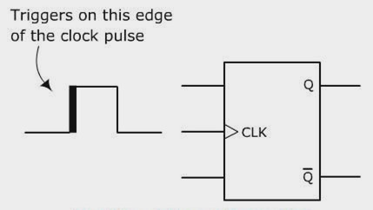
RECAP OF IMPORTANT TERMS & CONCEPTS
Clock: In digital circuit design clock means a signal that oscillates between 0 and 1 in a regular fashion.
All computers are constructed using a clock running at constant rate.
Ticks of the clock act as synchronizing events that keep other. components in step with each other.
Positive clock edges: Transitions of the clock from 0 to 1
Negative clock edges: Transitions from 1 to 0
Positive edge Triggering

Slide 3
RECAP OF IMPORTANT TERMS & CONCEPTS
Clock Pulse: The region between a positive and negative clock
edge
Microoperation: An elementary operation performed on one or
more registers during a single clock pulse
e.g. R2 ← R1
R2
Clock
pulse
n
R1
Clock pulse is used to synchronize microoperations.

Slide 4
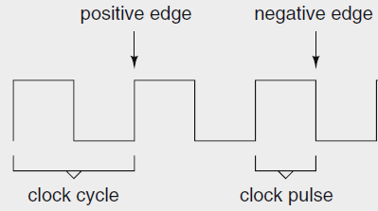
RECAP OF IMPORTANT TERMS &CONCEPTS
Clock cycle: The time interval between one positive or negative
edge and the next positive or negative edge, respectively.
– Or the amount of time between two pulses.
Features of a clock
Clock cycles are also known as clock periods, ticks, clock ticks, or cycles

Slide 5
IMPORTANT TERMS & CONCEPTS
Clock cycle is referred to in 2 ways
in terms of time duration, e.g. 1 ns (called clock cycle time)
or in terms of its rate, e.g. 1 Hz (called clock rate)
» The number of clock cycles that occur each second is the clock rate
or clock frequency (one cycle per second = 1 Hz)
» 1 Hz = 1 cycle/second or (1 Hz = 1/second)
» The clock rate is measured in millions of cycles per second (MHz) or billions of cycles per second (GHz)
» Clock cycle time = 1 / clock rate

Slide 6
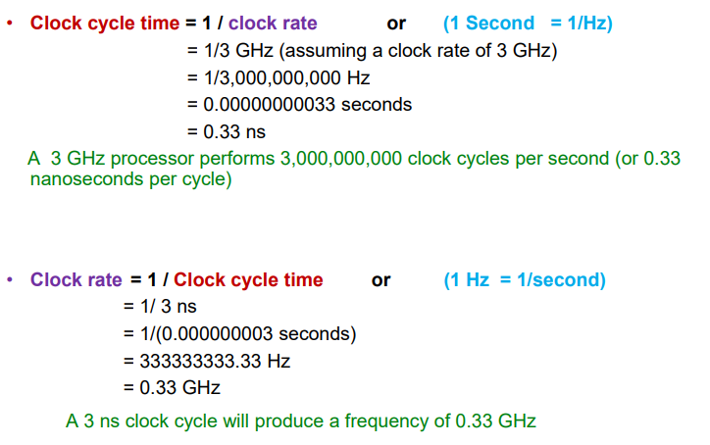
IMPORTANT TERMS & CONCEPTS

Slide 7







CPU PERFORMANCE EQUATION
CPU time = CPU clock cycles for a program x Clock cycle time
– What would be the CPU time for the Basic Computer program having a
single ADD instruction, if the clock cycle time is 3ns?
T0: AR ← PC
T1: IR ← M[AR],
PC ← PC+1
T2: Decode
IR(12-14),
AR←IR(0-11), I ← IR(15)
T3: no operation T₄: DR ← M[AR] T₅:AC ← AC+DR,
because direct addressing is used
SC ← 0
Assuming clock cycle time of 3ns, the CPU time for the ADD instruction is:
CPU time = CPI x clock cycle time = 6 x 3ns = 18 ns
» CPI = Clock cycles per instruction
For a program having 2 ADD instructions, the CPU time will be:
CPU time = 2 x 6 x 3ns = 36 ns
So, we can have the following generic formula for CPU time of a program:
CPU time = nu mber of in structions x CP I x clock cycle time

Slide 8
RULES OF THUMB FOR IMPROVING PERFORMANCE
Exploiting Parallelism
Principle of Locality
Focusing on the Common Case

Slide 9
RULES OF THUMB FOR IMPROVING PERFORMANCE
Exploiting Parallelism
Principle of Locality
Focusing on the Common Case

Slide 10
RULES OF THUMB FOR IMPROVING PERFORMANCE
Exploiting Parallelism
» Instruction-level parallelism
» Data-level parallelism
» Thread-level parallelism
Principle of Locality
Focusing on the Common Case

Slide 11
RULES OF THUMB FOR IMPROVING PERFORMANCE
Exploiting Parallelism
» Instruction-level parallelism
» Data-level parallelism
» Thread-level parallelism
Principle of Locality
Focusing on the Common Case
We will begin with Instruction-level parallelism

Slide 12
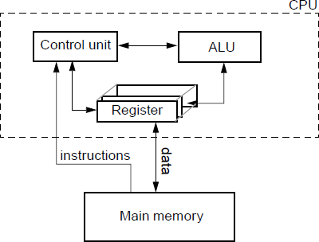
THE VON NEUMANN ARCHITECTURE

Slide 13
PARALLEL PROCESSING
Execution of concurrent events (processing tasks) in order to achieve a performance gain
Classes (also called levels or techniques) of parallel Processing
Instruction level
Data level
Thread level
Instruction Level Parallelism (ILP): Instead of processing each instruction sequentially, as in a conventional computer, concurrent processing is performed to increase instruction throughput.
Overlapping the execution of multiple instructions in order to improve
performance.
Throughput here means the total amount of instructions completed in a unit time

Slide 14
INSTRUCTION LEVEL PARALLELISM
ILP is implemented through Pipelining.
Pipelining exploits parallelism that exists among the actions needed to execute an instruction.
It is a widely used technique to enhance production.

Slide 15
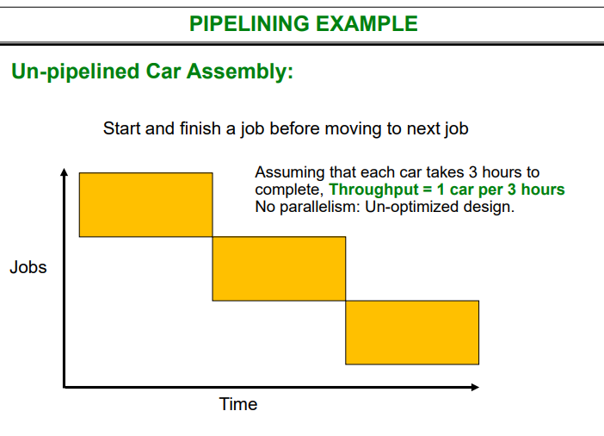

Slide 16
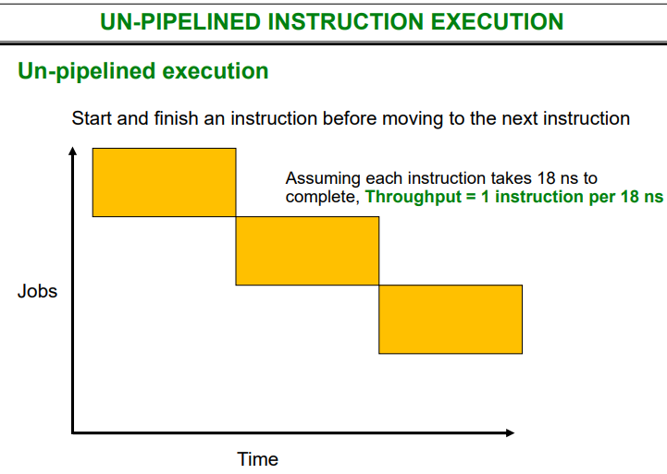

Slide 17
PIPELINING EXAMPLE
Pipelined Car Assembly
Break the job into smaller equal size stages
P = Painting (1 hour),
I = Interior fitting (1 hour),
E = Engine fitting (1 hour).
P I E
P I E
Throughput = 1 car per hour
Jobs
i.e. Three fold improvement in throughput by using pipelining.
P I E
P I E
Time
Lets look at a car assembly pipeline at Mercedes Bremen Plant

Slide 18
UN-PIPELINED INSTRUCTION EXECUTION
CPU time = CPU clock cycles for a program x Clock cycle time
– Example: Basic Computer program having a single ADD instruction
T0: AR ← PC
T1: IR ← M[AR],
PC ← PC+1
T2: Decode
IR(12-14),
AR←IR(0-11), I ← IR(15)
T3: no operation T₄: DR ← M[AR] T₅:AC ← AC+DR,
because direct addressing is used
SC ← 0
Assuming clock cycle time of 3ns, the CPU time for the ADD instruction is:
CPU time = CPI x clock cycle time = 6 x 3ns = 18 ns
» CPI = Clock cycles per instruction
For a program having 2 ADD instructions, the CPU time will be:
CPU time = 2 x 6 x 3ns = 36 ns
So, we can have the following general formula for CPU time of a program:
CPU time = nu mber of in structions x CP I x clock cycle time

Slide 19
UN-PIPELINED INSTRUCTION EXECUTION
Un-pipelined execution
Start and finish an instruction before moving to the next instruction
Assuming each instruction takes 18 ns to
complete, Throughput = 1 instruction per 18 ns
Jobs
Time

Slide 20
PIPELINING INSTRUCTIONS
Just as a car can be assembled in three parallel stages, we will see how a pipelined instruction cycle may increase throughput of a computer.
– But first we need to breakdown instruction execution into almost equal segments/stages
A machine instruction is executed in the following cycle:
Fetch an instruction from memory
Decode the instruction
Execute the instruction
After an instruction is executed, the cycle starts again
at step 1, for the next instruction

Slide 21
PIPELINING INSTRUCTIONS
Recall Basic Computer
Memory-Reference Instruction format
15 14
12 11
0
I | Opcode | Address
Fetch and Decode (applies to all memory, register, I/O reference instructions) T0: AR ← PC
T1: IR ← M[AR], PC ← PC + 1
T2: D0, . . . , D7 ← Decode IR(12-14), AR ← IR(0-11), I ← IR(15)
T3: If the instruction has an indirect address, i.e. IR(15) = 1,
Read the effective address from memory: AR ← M[AR]
Execute
AND to AC
T₄: T₅: | DR ← M[AR] AC ← AC ∧ DR, SC ← 0 | Read operand AND with AC
ADD to AC T₄: | DR ← M[AR] | Read operand
T₅: | AC ← AC + DR, E ← C_{out}, SC ← 0 | Add to AC and store carry in E

Slide 22
PIPELINING INSTRUCTIONS
CPU time = CPU clock cycles for a program x Clock cycle time
– Example: Basic Computer program having a single ADD instruction
T0: AR ← PC
T1: IR ← M[AR],
PC ← PC+1
T2: Decode
IR(12-14),
AR←IR(0-11), I ← IR(15)
T3: no operation T₄: DR ← M[AR] T₅:AC ← AC+DR,
because direct addressing is used
SC ← 0
– Assuming clock cycle time of 3ns, the CPU time for the ADD instruction is:
CPU time = CPI x clock cycle time = 6 x 3ns = 18 ns

Slide 23
PIPELINING INSTRUCTIONS
Executing instructions
Pipelined
Break the job into smaller stages F = fetch (~6ns)
D = decode (~6ns)
E = execute (~6ns)
Throughput = 1 instruction per 6 ns
F | D | E
 | F | D | E
 |  | F | D | E
 |  |  | F | D | E
Jobs
Time

Slide 24
PIPELINING INSTRUCTIONS
Pipelining is an implementation technique whereby multiple instructions are overlapped in their execution
Instructions are decomposed into several pipe segments (steps or stage)
Different segments process different parts of different instructions in parallel (i.e. several processings may be in progress in distinct segments simultaneously)
Instructions enter at one end of the pipe, progress through various stages and exit at the other end
Throughput of the pipeline is determined by how often an instruction exits the pipeline

Slide 25




PIPELINING INSTRUCTIONS
Overlapping of instructions is made possible by associating a register with each segment in the pipeline
– Each segment consists of an input register (to hold data) followed by a combinatorial circuit (that performs the required sub-operation)
Example Structure of a 4-Segment Pipeline
Clock
S₁
R₁
S₂
R₂
S₃
R₃
S₄
R₄
Input
The registers provide isolation between each segment so that each can operate on distinct data simultaneously
The output (intermediate result) from one segment is applied to the
input register of the next segment
A clock is applied to all registers to ensure information flow through the pipeline one step at a time

